Slide 1
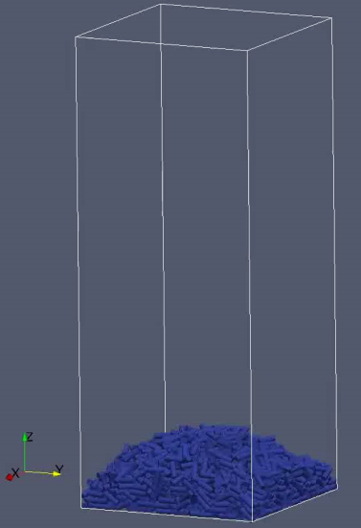
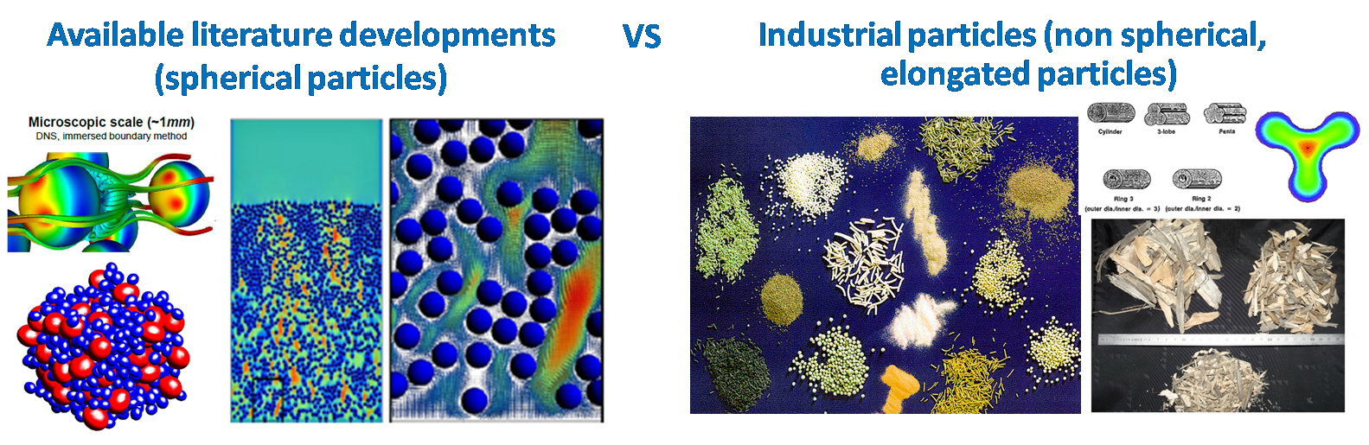
Experimental study of liquid solid fluidised bed impact of particle shape
Context : CFD multi-scale modelling of liquid solid fluidized beds with non spherical particles
Need to develop appropriate closure laws for non spherical particles (fluid-solid and particle-particle interactions)
Internship objective : provide experimental results (local measurements) of liquid solid fluidized bed with cylindrical particles to be used for validation of CFD simulations

Slide 2
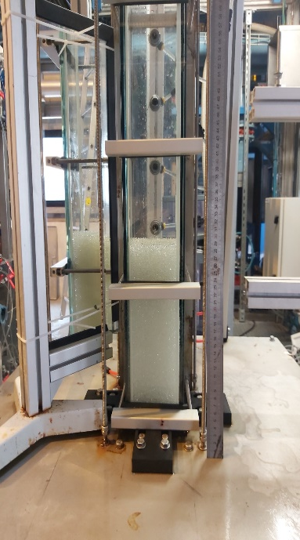
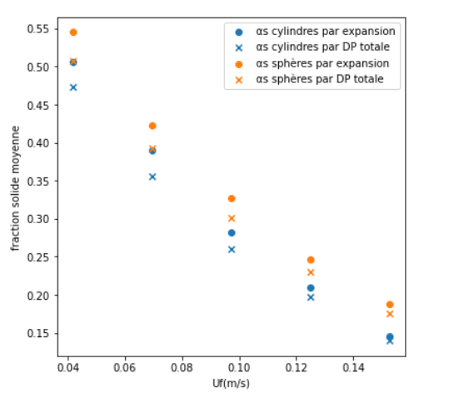
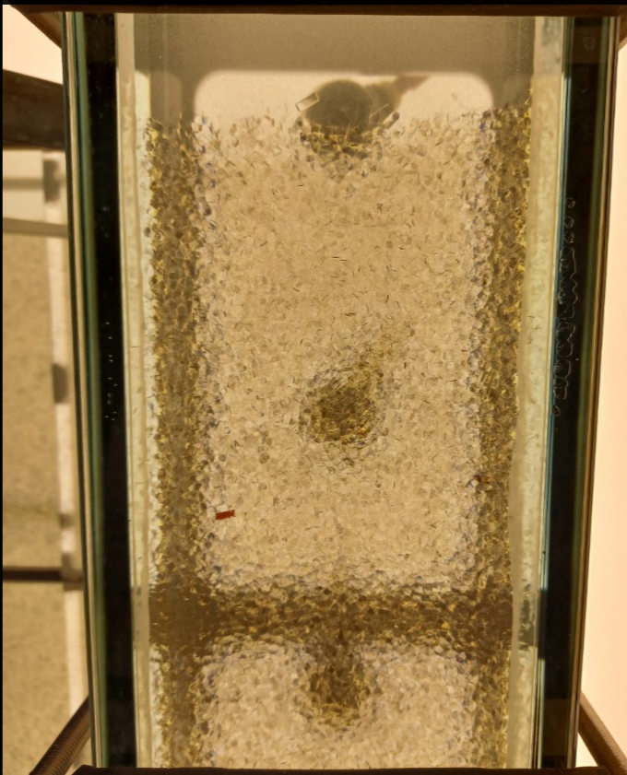
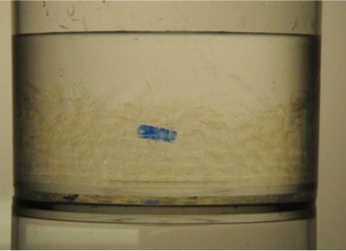
Experimental set up and Previous work
Small rectangular column : a~10 cm/H~200 cm/ ~100000 cylindrical particles (dp= 2mm L=5mm)
Previous internship provided (2021) :
Overall measurements: pressure drops and bed expansions
Local measurements : fast camera videos for particle tracking with first results of trajectories and velocities
Fluidization curves
Optical index matching

Slide 3
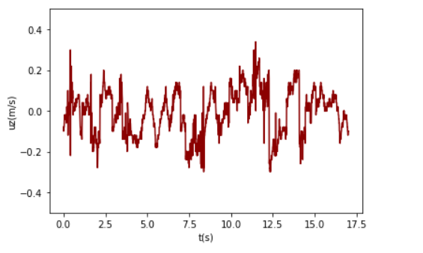
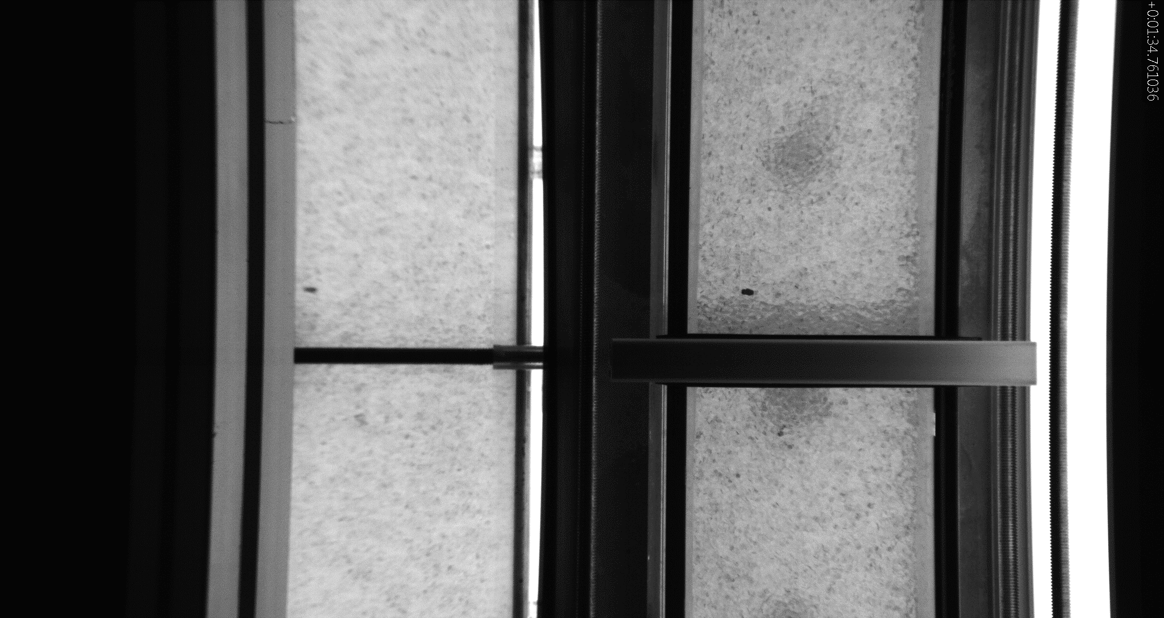
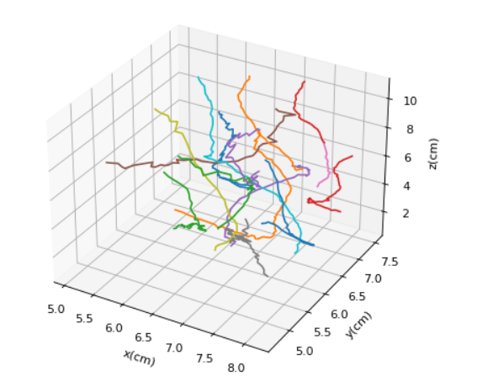
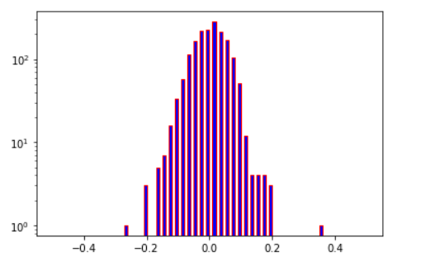
Main objectives of the internship
Local measurements :
3D trajectories
Velocities
Particles orientation: to be developed
Processing the results, statistical and phenomenological analysis and comparison to literature
routines available but need further development
Uz(t)
Particles trajectories
PDF Uz

